Slide 1
University for Development Studies
Faculty of Natural Resources and Environment
Department of Ecotourism and Environmental Management
HOTELIERS’ RESPONSE TO EMERGING INFECTIOUS DISEASE THREATS: A STUDY OF HOTELS IN ACCRA METROPOLIS
Colloquium Presentation
By: Philip Ebo Quansah

Slide 2
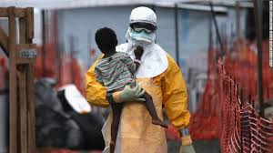
Outline of Presentation
Introduction
Theoretical and conceptual framework
Methods
Results and discussions
Conclusions and recommendations
y

Slide 3
Definition of terms
Hotelier: As used in this study refers to hotel managers who are pursuing a career in hotel management and are in the position to take strategic management decisions.
Infectious Disease: An illness caused by a specific infectious agent that is spread from an infected person, animal, or inanimate reservoir to a susceptible host, directly or indirectly through an intermediate plant or animal host, vector, or the inanimate environment.
Threats/Risk: Which is used interchangeably in this paper to mean the likelihood of something happening and the consequences if it happens (Beer and Ziolkowski, 1995).
Upscale hotels: this includes 3 to 5-star accommodation establishments that provide high quality products and services.
Small scale hotels: Made up of 1 and 2-star accommodation establishments that offer affordable prices with good services and facilities to match.
Health Threat: Is defined as infectious diseases that spread quickly and widely and usually throughout more than one country that has the potential to affect long-term confidence in an organization or a product, or which may interfere with its ability to continue operating normally.

Slide 4
Introduction
Travel and hospitality have always been confronted with elements of threat. Threats have become an important part of the hospitality industry and its operating environment (Goodrich, 2002)
The types of threats include financial, health, physical, crime and terrorism, social, psychological, and natural disaster (Wilks & Page, 2003).
Outbreaks of infectious diseases have occurred throughout history, dramatically shaping the human experience and perception over time.

Slide 5
Introduction Cont’d
In the past few decades, one or two new infectious disease threats have emerged every year, somewhere in the world …. (Gresham et al., 2013).
The linkage between health and security is connected to the increased perceived threat of bioterrorism and outbreaks of infectious diseases.
Globalization and the increase of movement of people around the globe have accelerated the diffusion of infectious diseases rendering them a global threat.
Notes:
2….. after September 11 (the Anthrax case)

Slide 6
Introduction cont’d
The UN Security Council, for the first time in its practice, classified an infectious disease as a ‘threat to peace and security’ according to Article 39 of the UN Charter (Pavone, 2016)
Africa has had its fair share of threatening infectious diseases over the years with the most recent one being the Ebola outbreak.

Slide 7
Introduction cont’d
While exposure to naturally or intentionally occurring, highly transmissible infectious diseases poses a global risk, certain industries …….
The accommodation business sector has been acknowledged by the Government of Ghana as an important sector that plays a significant role in Ghana’s tourism industry (NTDP, 2013-2027).
However, in our tightly connected world, infectious disease threats resonate across borders to impact directly or indirectly, sharply and/or unexpectedly on organizations, industries and states.
Notes:
…..including aviation, hospitality, sports, entertainment, transportation, and tourism tend to suffer severe losses due to a decrease in public gatherings, and travel.

Slide 8
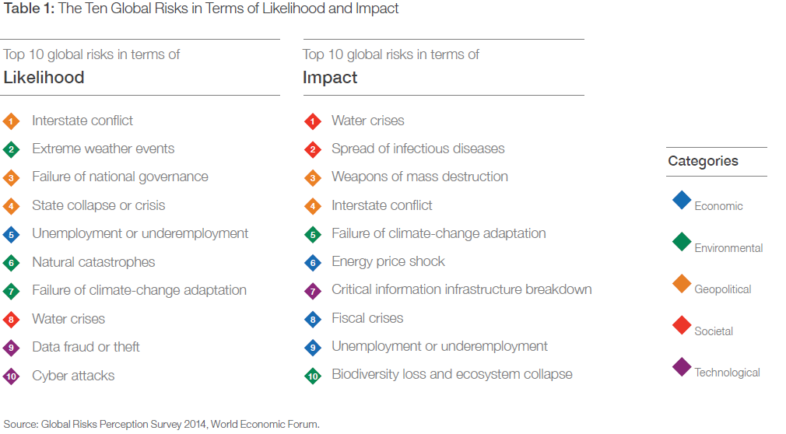

Slide 9
So what’s the issue?
While a natural disaster can impede the flow of tourism, recent health threats tend to intimidate the traveling public more severely (Sonmez et al., 1999)
Ritchie (2003, p. 4) warns “that it is no longer a case of ‘if’ an organization will face a crisis/disaster; it is rather a question of ‘when’, ‘what type’, and ‘how prepared’ the organization is to deal with it.”
Much of the literature on tourism risk/disaster management has been from the viewpoint of the central coordinator rather than individual businesses (e.g., Susilovic & Sertic, 2010)……

Slide 10

What are the perceptions of hoteliers towards emerging infectious disease issues?
To what extent are hotels vulnerable to health threats?
What are the responses of hoteliers to these threats?

Slide 11
Therefore the following aims were set to guide the study:
Explore the vulnerability of hotels to infectious disease threats.
Examine the perceptions of hoteliers towards emerging infectious diseases
Analyze the response strategies of hoteliers in the wake of infectious disease threats

Slide 12
Theoretical issues
Risk Management theory
  five major activities: establish the context, identify risks, analyze risks, evaluate risks and treat risks.
  Based on two enabling activities (communication and consult, and monitor and review)
Tourism Disaster Risk Management Theory (Faulkner, 2001)
  Involve three key stages: Before a disaster (pre-disaster), During a disaster (disaster occurrence), and After a disaster (post-disaster).
Notes:
The three key stages of activities that are taken up within disaster risk management are as follows; Before a disaster (pre-disaster), During a disaster (disaster occurrence), and After a disaster (post-disaster).

Slide 13
CONCEPTUAL FRAMEWORK
Source: Author’s construct, 2016.
Health threat perception
Hoteliers’ response strategies
Implications
Hotel’s perceived vulnerability
Hotel characteristics
Notes:
the study, which is situated in the pre-disaster phase (of the Disaster Risk Management Theory) based upon five major activities: establish the context, identify risks, analyze risks, evaluate risks and treat risks. The framework is also underpinned by Della-Giustina’s (2003) three steps essential in emergency planning: to recognize existing risks, to develop an updated emergency plan, and finally to assure the organization’s preparedness for the emergencies.

Slide 14
Methods
Study area: Accra metropolis
Research philosophy: Mixed method (Concurrent nested strategy)
Study design: Exploratory research design
Target population: Hotel Managers of 1 to 5-star hotels
Data sources:
Primary: interview guide and questionnaire
Sampling techniques:
Quantitative: multi-stage sampling
purposive sampling
proportionate sampling
convenience sampling
      Qualitative: purposive and convenient sampling
Notes:
Concurrent Nested (Embedded) Design – This design includes one phase of data collection in which priority is given to one approach that guides the project, while the other approach is embedded or nested into the project and provides a supporting role. The embedded approach is often addressing a different question then the primary research question.

Slide 15
Methods cont’d
  Sample size
  Quantitative = 63
  Qualitative = 8
  Data collection:
  pre-test: 4th-13th^{th} April, 2016
  actual field: 21st April-24th June, 2016
  Data analysis
    Quantitative data:
  SPSS version 21
  Frequencies
  Chi square
    Qualitative data:
    Manual transcription
    Thematic analysis

Slide 16
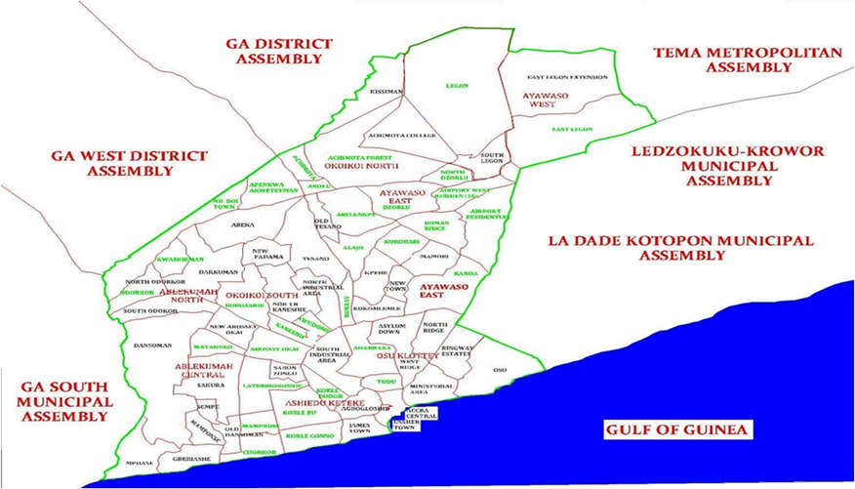
Map of Study Area

Slide 17
Results and Discussions
Socio-demographic summary of respondents
  Position: General manager = 32 (50.8%)
  Sex: Male = 40 (63.5%)
  Age: Range from 21years-53years
  group 30-39 (33.9%)
  Educational attainment: First degree = 38 (60.3%)
  Tourism and hospitality Mgt background: No = 32 (55.6%)
  Nationality: Ghanaian = 63 (100%)
  Years working in their capacity: range (4months- 22years) with ≤ 5years being the dominating working capacity of respondents (73.0%)

Slide 18
Results and Discussions
Hotel Characteristics
Years operations: range from 2 to 36 with most hotels being in operations for 10-6 years (46.8%)
Operational rooms: 50 rooms and below= 41 (65.1%)
Annual average occupancy rate = 69.74%
Fall in occupancy during Ebola outbreak: Yes=33 (52.4%)
Average occupancy rate during Ebola threat= 40.35% representing 29.39% fall
Ownership type: sole proprietorship = 42 (66.6%)
Leading clientele: walk-in Guest = 36 (23.1%)

Slide 19
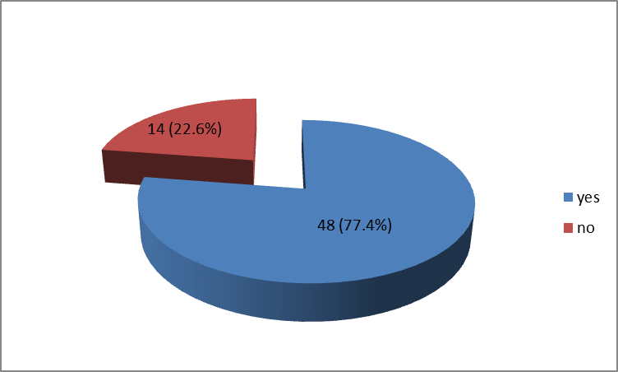
Aim 1
Perceived vulnerability to health threats

Slide 20
Views shared
“I would say every hotel in Ghana is extremely vulnerable to these health issues. Its difficult to detect if someone is carrying a deadly disease around. ….. You would not know who is carrying what, and we don’t have the sophisticated technologies to help us know” (a 3star hotel HR manageress)
“we are very vulnerable because these diseases have national appeal and what happens in Ghana automatically affects the hotel industry so its not like we are immune from national issues” (a 4star hotel HR manager)
“We are very vulnerable as far as our overall health system is not ready and good enough to manage and handle health threats. We were just lucky we did not record any Ebola case in Ghana” (A Human Resource Manager of a 4-Star hotel

Slide 21
Vulnerability based on service characteristics
Scale: (Disagree=0-2.49, Neutral=2.5-3.49, Agree=3.5-5.0)
Notes:
Smith 2005

Slide 22
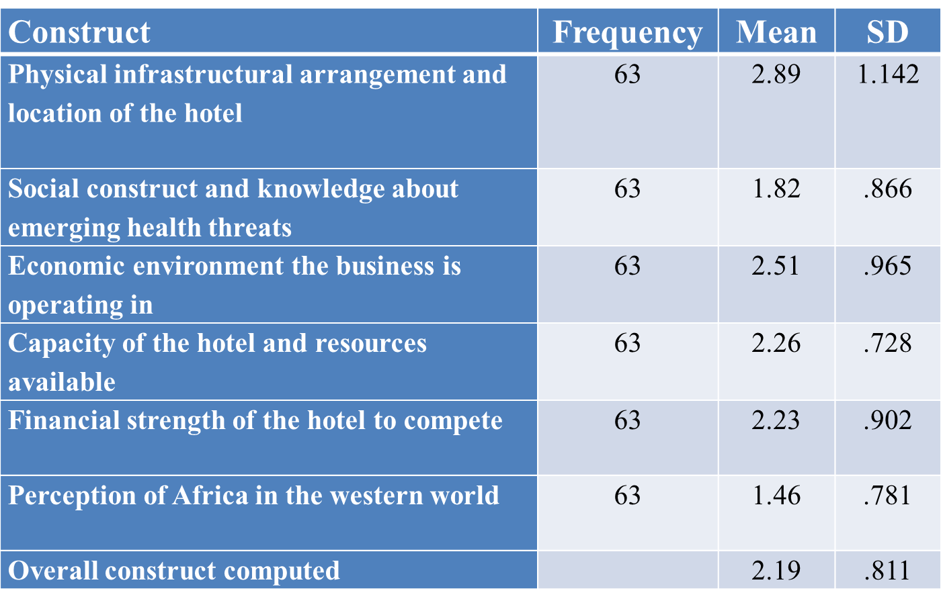
Vulnerability Constructs
Scale: (High=1-1.49, Moderate=1.5-2.49, Low=2.5-3.49, Not at all=3.5-4)

Slide 23
Hotel characteristics * Vulnerability

Slide 24
Aim 2
Perception towards emerging infectious disease issues
Emerging health issues as a threat

Slide 25
Shared views
“At the end of it it’s the country, whatever happens at the macro level feeds into the micro aspect so the whole country’s preparedness is key. So until the whole nation deals with this threat, no business including the hotel industry is safe from health threats” (a 4-star HR manager)
“anything that can affect the revenue or bottom line of a business should be considered a threat. So yes I see emerging health issues as a threat.” (a 1-star hotel manager)
“it might be a threat to the upscale hotels because it affects them more. To me its not a real threat because my hotel didn’t feel any impact during the Ebola period” (General manager of a 1-star hotel).

Slide 26
Determinants of threat perception
Scale: (Disagree=0-2.49, Neutral=2.5-3.49, Agree=3.5-5.0)
Statement | F | Percentage in agreement | M | SD
Hotels in Ghana feel the impact global infectious diseases | 63 | 77.8 | 4.00 | .876
Infectious disease outbreaks are on the increase | 63 | 74.6 | 3.67 | .967
Disruptive to hotel operations | 63 | 69.8 | 3.67 | .861
Increase prevalence of global infectious disease outbreaks is a concern | 63 | 82.6 | 4.11 | 1.284
Globalization has made infectious diseases borderless and highly uncertain | 63 | 84.1 | 4.10 | .962

Slide 27
Hotel characteristics against threat perception

Slide 28
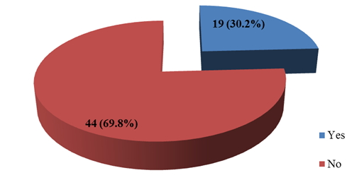
Aim 3
Hoteliers’ Response Strategies
Plan for managing external health threats

Slide 29
Views Shared
“Ghana has not been faced with any serious infectious disease outbreak yet so did not see the need for such plan” (view shared by a 2-Star hotel Manageress)
“we do not have the requisite skills and human resources for putting in place such plans” (said a 2-star Hotel Manager)
“we have a plan because our parent company (franchisor) always make sure we operate in accordance to set standards so immediately there was an Ebola outbreak, they sent us guidelines and things that must be done” (HR Manager of a 4-star hotel)

Slide 30
Preventive strategies

Slide 31
Preparedness Strategies

Slide 32
Strategic responses by hoteliers
Responses | Frequency | Percentage (%)
Adhere to general preventive measures | 49 | 27.5
Training employees on how to handle an outbreak | 32 | 18.0
Reduce room rate to attract local guest | 16 | 9.0
Educate all stakeholders | 16 | 9.0
Putting a health personnel on stand by | 15 | 8.4
Liaise with other organisations for information and support | 15 | 8.4
Screen staff members periodically | 12 | 6.7
Use the media to get information out to travelers and potential guest | 7 | 3.9
Stopped receiving guest from affected countries | 5 | 2.8
Report any suspected case immediately to appropriate bodies | 5 | 2.8

Slide 33
Conclusions
Hoteliers’ health threat perception was largely shaped by the fact that Globalisation has made infectious diseases borderless and highly uncertain
The hotel industry in Accra Metropolis was perceived to be vulnerable to infectious disease threats.
Hoteliers do recognize health threats as existing or potential risk and threat to their operations but just a hand full had a plan for managing external health threats.
The hotel industry in Accra Metropolis and for that matter Ghana as a whole is Ill prepared to handle any infectious disease outbreak

Slide 34
Recommendations
The Ministry of Tourism and Creative Arts should take leading role in putting together preventive and preparedness strategies and policies for stakeholders
Ghana Hotels Association should establish a hotel risk and safety board to develop measures and strategies to aid it members in the wake of health threats
For further studies:
A predictable holistic study that involves a synergy of all stakeholders and entities in health, tourism, transport, home affairs, international relations, and security

Slide 35

Thank you!

